Slide 1

General Chemistry CHE 101
Atoms, Molecules and Ions
Chapter 2
Dr. Sultana Bedoura

Slide 2
Outline
The Atomic Theory
The structure of the atom
Atomic number, mass number and isotopes
The Periodic Table
Molecules and ions
Chemical formulas
Naming compounds

Slide 3
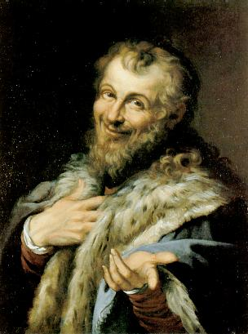
The Atomic Theory
In the fifth century B.C. the Greek philosopher Democritus said –
Matter consists of very small indivisible particles, named atomos (meaning uncuttable or indivisible)

Slide 4
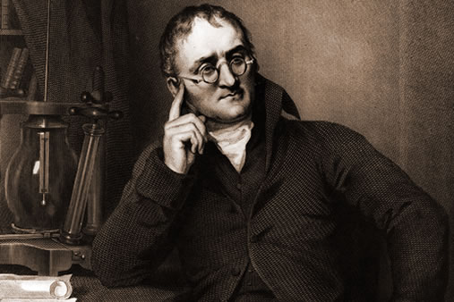
The Atomic Theory
1808 - English scientist and school
teacher, John Dalton, formulated a precise definition of the individual building block of matter that we call atom

Slide 5
Dalton’s Atomic Theory (1808)
Elements are composed of extremely small particles called atoms.
All atoms of a given element are identical, having the same size, mass and chemical properties. The atoms of one element are different from the atoms of all other elements.
Compounds are composed of atoms of more than one element. In any compound, the ratio of the numbers of atoms of any two of the elements present is either an integer or a simple fraction.
A chemical reaction involves only the separation, combination, or rearrangement of atoms; it does not result in their creation or destruction

Slide 6
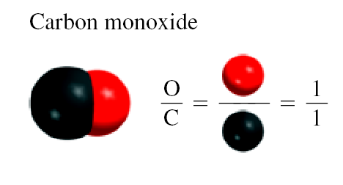
Dalton’s Atomic Theory
(Hypothesis no. 3)
Law of Definite Proportions (Joseph Proust 1799)
“different samples of the same compound always contain its constituent elements in the same proportion by mass”
− the ratio of the masses of different elements in a given compound is fixed
− the ratio of the atoms in the compound is also constant

Slide 7
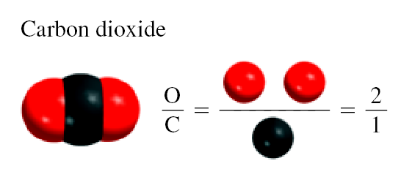
Dalton’s Atomic Theory
(Hypothesis no. 3)
Law of Multiple Proportions
“if two elements can combine to form more than one compound, the masses of one element that combine with a fixed mass of the other element are in ratios of small whole number”

Slide 8
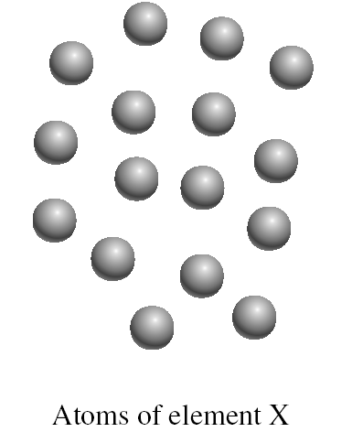
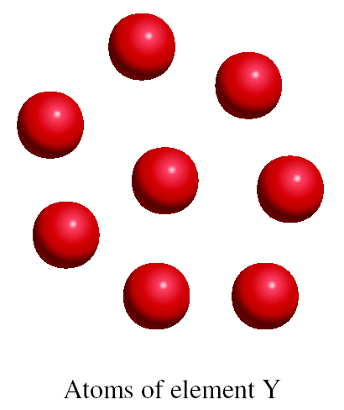
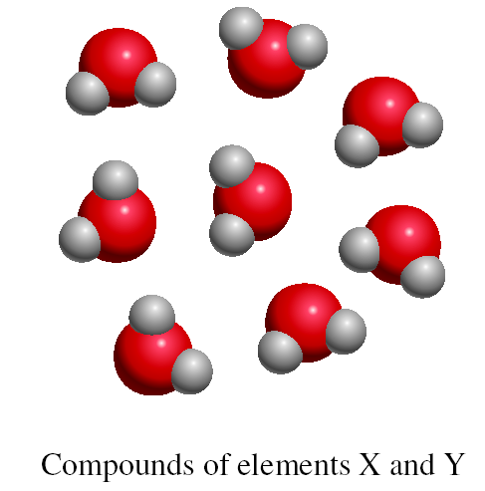
Dalton’s Atomic Theory
Hypothesis no. 1, 2, & 4
16 X
+
8 Y
8 X₂Y
Law of Conservation of Mass
“matter can be neither created nor destroyed”

Slide 9
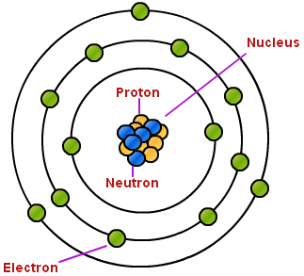
Structure of the Atom
Atom: the basic unit of an element that can enter into chemical combination.
Atom has internal structure and the smaller particles are called subatomic particles-
electron
proton
neutron
-
Notes:
The picture above is an example of the arrangement of the particles in an atom. Most of the atom is just empty space. The center of the atom consists of a positively charged nucleus of protons and neutrons that are surrounded by a cloud of negatively charged electrons. An atom is an extremely small particle of matter that retains its identity during chemical reactions. in an electrically neutral atom, the positive charge of the protons, combined with the negative charge of the electrons, would result in no charge because they would cancel each other out.

Slide 10
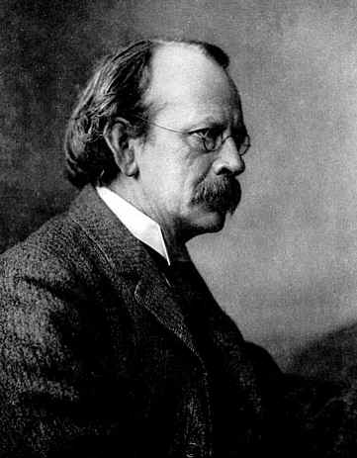
The Electron
Joseph John Thomson (1856 – 1940), British physicist received the Noble Prize in Physics in 1906 for discovering the electron.

Slide 11
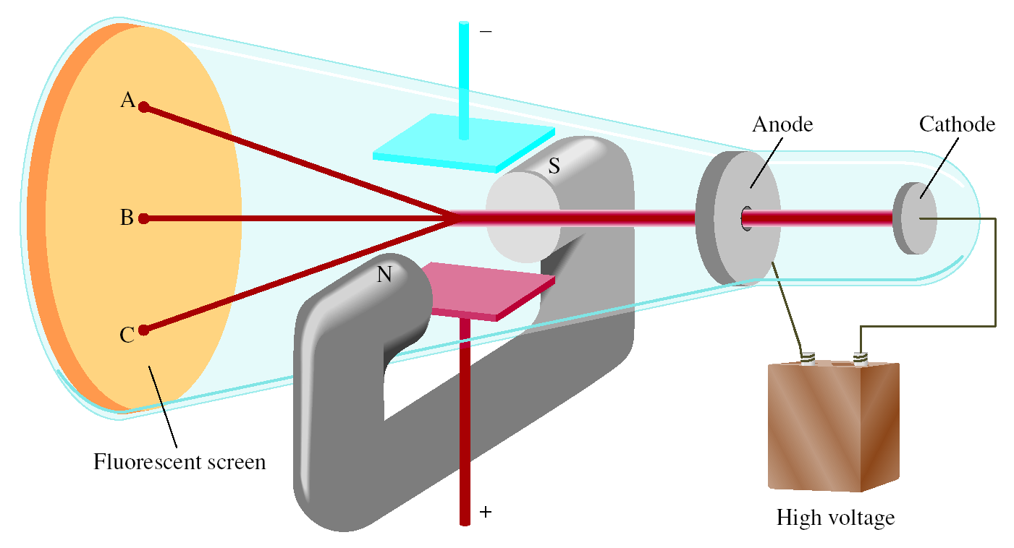
Cathode Ray Tube
+ve charged
-ve charged
A = mf on C = ef on B = both off
J.J. Thomson, measured mass/charge of e⁻ (1906 Nobel Prize in Physics)

Slide 12
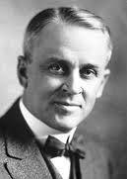
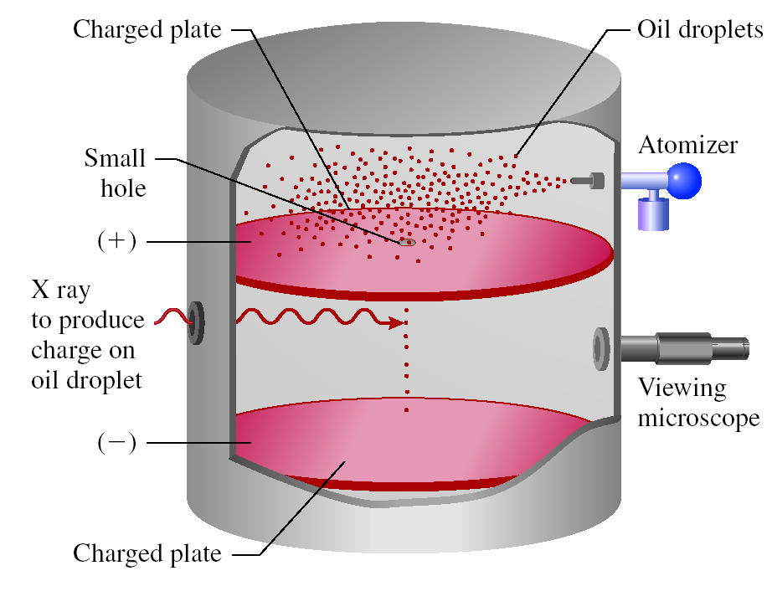
The charge of electron
Robert Andrew Millikan (1868 – 1953), American physicist received the Noble Prize in Physics in 1923 for determining the charge of the electron

Slide 13
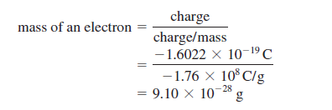
The mass of electron
Millikan’s e⁻ charge = -1.60 x10⁻¹⁹ C
Thomson’s (charge/mass) of e⁻ = -1.76 x 10⁸ C/g
Mass of electron = 9.10 x 10⁻²⁸ g

Slide 14
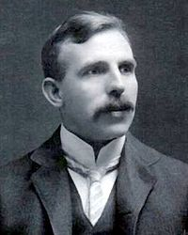
Proton
Ernest Rutherford (1871 – 1937), New Zealand Physicist worked in England received the Noble Prize in Chemistry in 1908 for discovering the structure of atomic nucleus

Slide 15
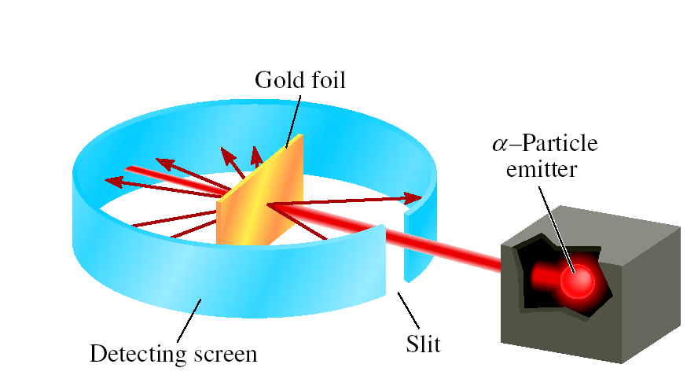
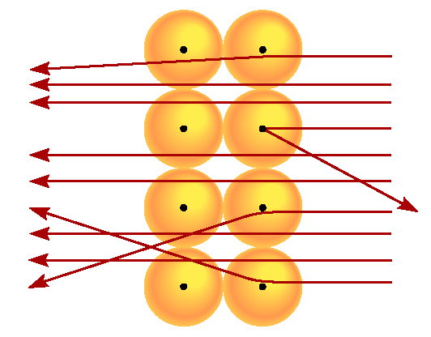
Rutherford’s Experiment
Atom’s positive charge is concentrated in the nucleus
proton (p) has opposite (+) charge of electron (-)
mass of p is 1840 x mass of e - (1.67 x 10⁻²⁴ g)
Notes:
In this experiment, very thin foils of gold and other metals were used as targets for α particle from a radioactive source. They observed that the majority of the particles penetrated the foil either undeflected or with only a slight deflection. But every now and then an alpha particle was scattered at a large angle. In some instances, α particle actually bounced back in the direction from which it had come! Rutherford later explained the structure of the atom in terms of new model- most of the space in atom is free. This explains why the majority of the alpha particles passed through the gold foil with little or no deflection. The atom’s positive charges, Rutherford proposed, are all concentrated in the nucleus, which is a dense central core within the atom. Whenever, an α particle came close to a nucleus in the scattering experiment, it experiences a large repulsive force and therefore a large deflection. Moreover, α particle travelling directly toward a nucleus would be completely repelled and its direction would be reversed.

Slide 16
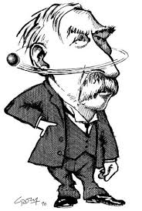
Rutherford’s postulation
Atom has a tiny dense central core or the nucleus which contains practically the entire mass of the atom, leaving the rest if the atom almost empty
The entire positive charge of the atom is located on the nucleus, while electrons were distributed in vacant space around it
The electrons were moving in orbits or closed circular paths around the nucleus
like planets around the sun

Slide 17
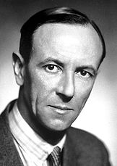
The Neutron
James Chadwick (1891 – 1972), British physicist received the Noble Prize in Physics in 1935 for discovering the neutrons

Slide 18
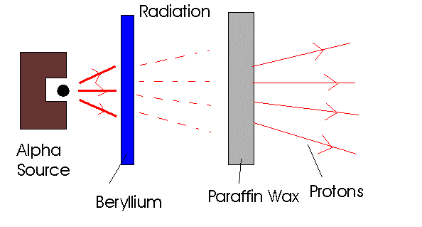
Chadwick’s Experiment
In 1932 Sir James Chadwick discovered neutron.
A stream of alpha particles were directed at a beryllium target.
He found that a new particle were ejected who has a property like γ ray. It has almost the same mass as the proton and has no charge.
a + ⁹Be
¹n + ¹²C + energy
H atoms - 1 p; He atoms - 2 p
mass He/mass H should = 2
measured mass He/mass H = 4

Slide 19
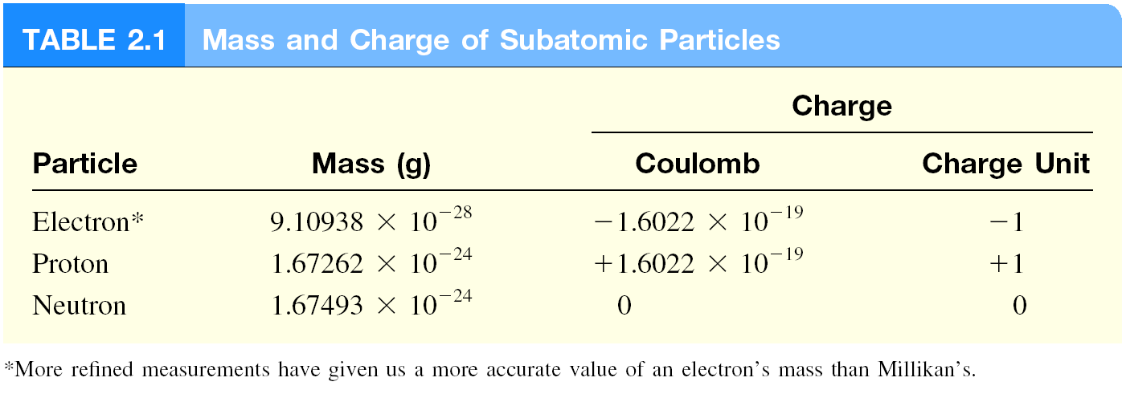
Subatomic Particles
mass p ≈ mass n ≈ 1840 x mass e⁻

Slide 20
Atomic number, Mass number & Isotopes
Atomic number (Z) : Chemical identity of an atom
Z = number of protons (p) in nucleus
In a neutral atom,
number of electrons (e) = number of protons (p)
Mass number (A): the total number of neutrons (n) and protons in the nucleus of an atom
A = p + n = Z + n
∴n = A- Z
Isotopes: atoms of the same element (X) with different numbers of neutrons in their nuclei
Mass Number
A
X
Element Symbol
Atomic Number
Z
1
2
3
235
238
H
H (D)
H (T)
U
U
1
1
1
92
92

Slide 21
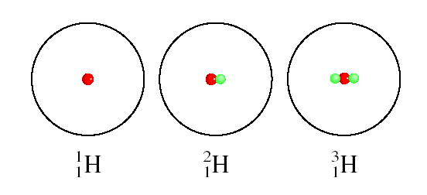
The Isotopes of Hydrogen
Hydrogen
Deuterium
Tritium

Slide 22
Counting Protons, Neutrons & Electrons
14
How many protons, neutrons, and electrons are in
C
?
6
6 protons,
8 (14 - 6) neutrons,
6 electrons
11
How many protons, neutrons, and electrons are in
C
?
6
6 protons,
5 (11 - 6) neutrons,
6 electrons

Slide 23
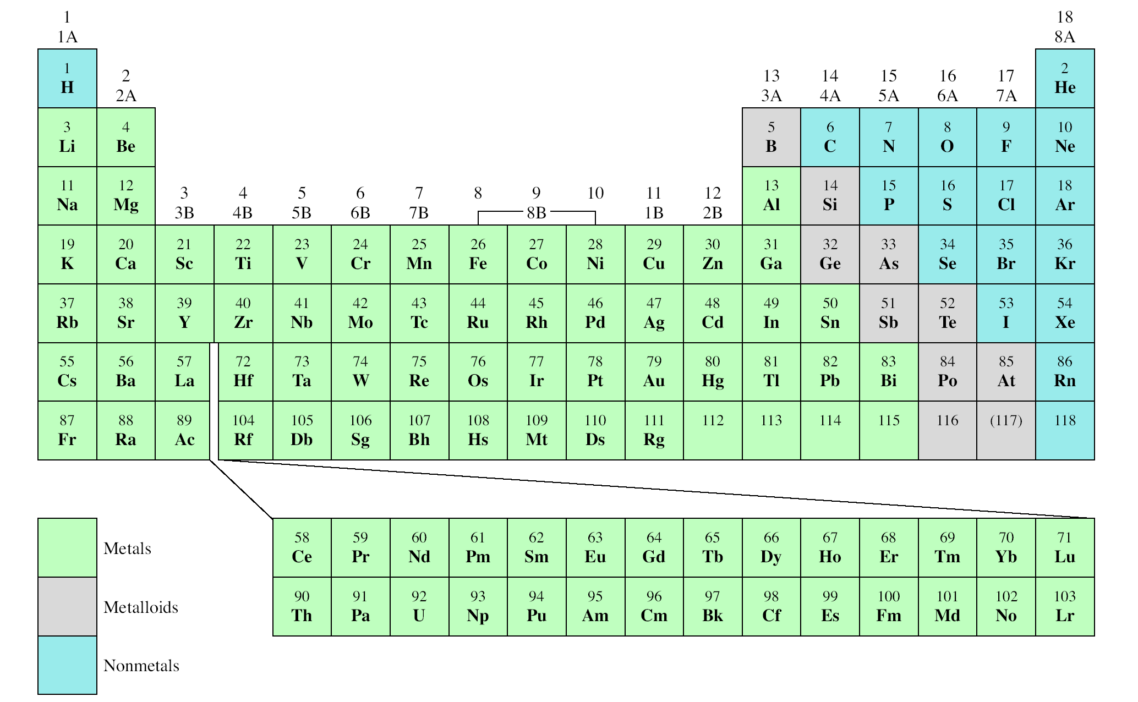
The Modern Periodic Table
Alkali Metal
Noble Gas
Alkali Earth Metal
Group
Halogen
Period

Slide 24
Molecules
Molecules: is an aggregate of at least two atoms in a definite arrangement held together by chemical forces( bonds).
Molecules can contain atoms of same elements or different elements.
They should join in a fixed ratio.
Electrically neutral like atom

Slide 25
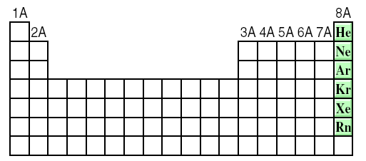
Monatomic gases
Of all the elements, only the six noble gases in Group 8A exist in nature as single atoms, called monatomic gases
Most matter is composed of molecules or ions formed by atoms.

Slide 26
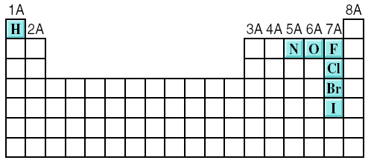
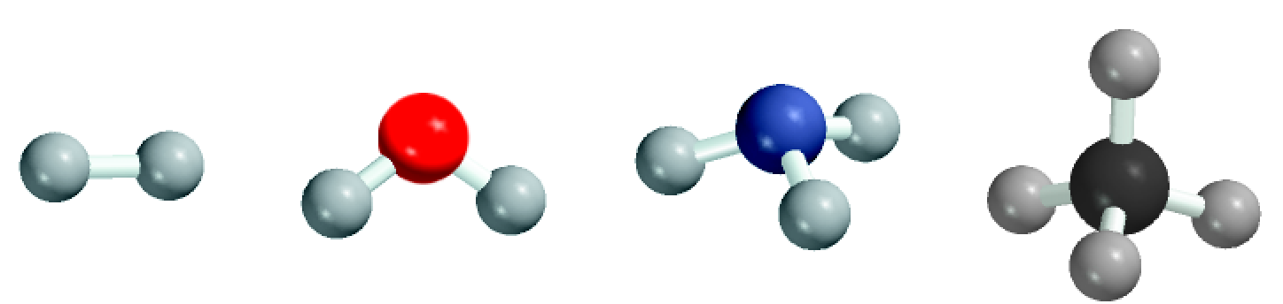
Diatomic & polyatomic molecules
A diatomic molecule contains only two
atoms.
A polyatomic molecule contains more
than two atoms
H₂, N₂, O₂, Br₂, HCl, CO
diatomic elements
H₂
H₂O
NH₃
CH₄
O₃, H₂O, NH₃, CH₄

Slide 27
Ions
Cation – ion with a positive charge. If a neutral atom loses one or more electrons, it becomes a cation
Anion – ion with a negative charge. If a neutral atom gains one or more electrons, it becomes an anion.
.
Na
11 protons
11 electrons
Na⁺
11 protons
10 electrons
17 protons
17 electrons
Cl⁻
17 protons
18 electrons
Cl

Slide 28


Ions
NaCl is an ionic compound, because it is composed of cation (Na+) and anion (Cl-)
Notes:
An atom can loss or gain more than one electron. Example of ions formed by the loss or gain of more than one electron are Mg2+, Fe3+, S2- and N3-. These ions, as well as Na-, Cl- are called mono atomic ions. Because they contain one atom. In addition, Two or more atoms can combine to make ions that has net positive or net negative charges, they are polyatomic ions, eg, OH-, CN-, NH4+ etc.

Slide 29
Monatomic ions & polyatomic ions
A monatomic ion contains only one atom
A polyatomic ion, also known as a molecular ion, is a charged chemical species (ion) composed of two or more atoms covalently bonded or of a metal complex that can be considered to be acting as a single unit.
Na⁺, Cl⁻, Ca²⁺, O²⁻, Al³⁺, N³⁻
OH⁻, CN⁻, NH₄⁺, NO₃⁻

Slide 30
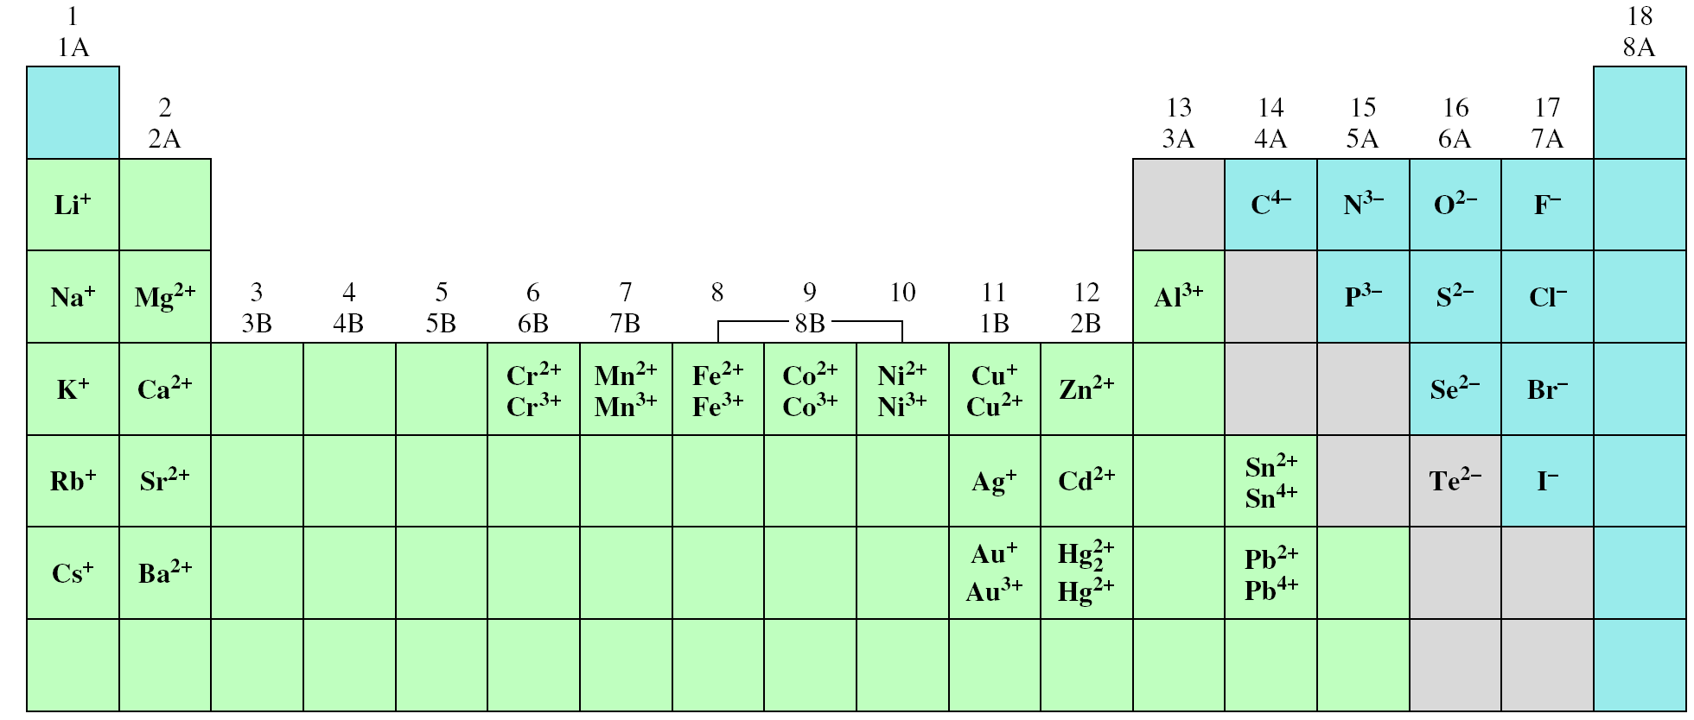
Common ions in Periodic Table

Slide 31
Counting protons, neutrons & electrons
27
3+
Al
How many protons, neutrons and electrons are in ?
13
13 protons,
14 neutrons,
10 (13 – 3) electrons
78
How many protons, neutrons and electrons are in ?
2-
Se
34
34 protons,
44 neutrons,
36 (34 + 2) electrons

Slide 32
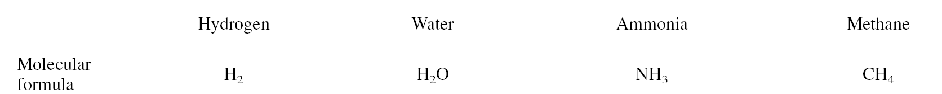
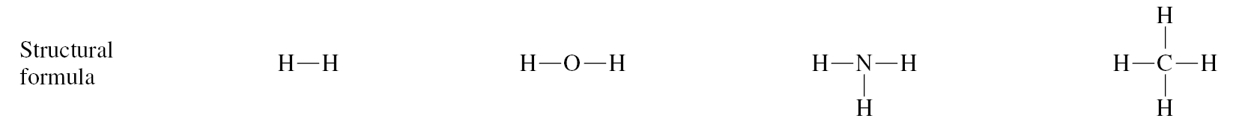
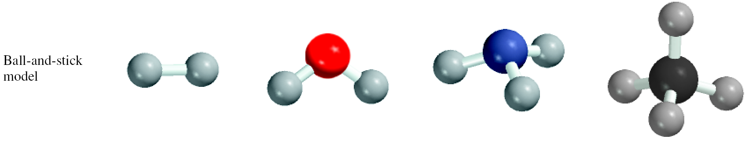
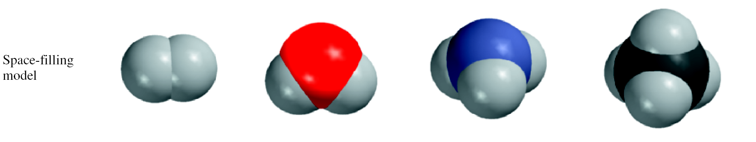
Formulas and models

Slide 33
Molecular & empirical formulas
A molecular formula shows the exact number of atoms of each element in the smallest unit of a substance.
An empirical formula shows the simplest whole-number ratio of the atoms in a substance.
molecular
empirical
H₂O
H₂O
C₆H₁₂O₆
CH₂O
O₃
O
N₂H₄
NH₂

Slide 34
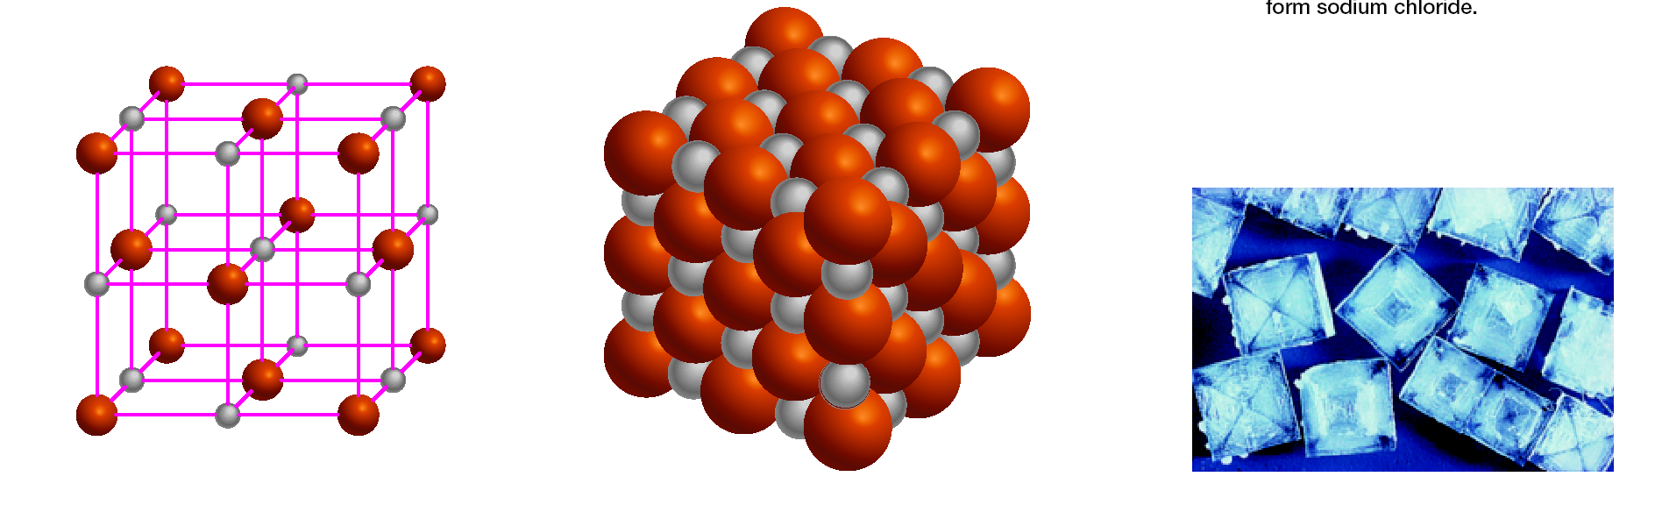
Ionic compounds
Ionic compound: A combination of cations and an anions.
The formula is usually the same as the empirical formula.
The sum of the charges on the cation(s) and anion(s) in each formula unit must equal zero.
The ionic compound NaCl

Slide 35
Formula of Ionic Compounds
2 x +3 = +6
3 x -2 = -6
Al₂O₃
Al³⁺
O²⁻
1 x +2 = +2
2 x -1 = -2
CaBr₂
Ca²⁺
Br⁻
2 x +1 = +2
1 x -2 = -2
Na₂CO₃
Na⁺
CO₃²⁻

Slide 36
Compounds
A chemical compound is a pure chemical substance consisting of two or more different chemical elements that can be separated into simpler substances by chemical reactions.
Chemical compounds have a unique and defined chemical structure; they consist of a fixed ratio of atoms.
They are held together in a defined spatial arrangement by chemical bonds.

Slide 37
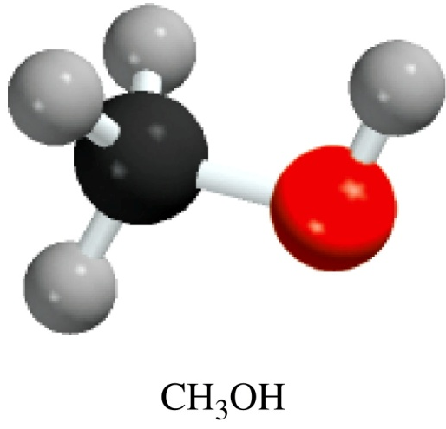
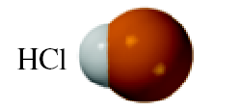
Naming of compounds
Organic compounds
Contain carbon.
Usually in combination with elements such as H, O, N, and S.
Can contain functional groups.
Inorganic compounds
All other compounds are classified as inorganic compounds.
CO, CO₂, CS₂, and compounds containing CN⁻, CO₃²⁻, and HCO₃⁻ groups.

Slide 38
Compounds
Characteristic properties of compounds:
Elements in a compound are present in a definite proportion
Example- 2 atoms of hydrogen + 1 atom of oxygen becomes 1 molecule of compound-water.
Compounds have a definite set of properties
Elements that comprise a compound do not retain their original properties

Slide 39
Naming compounds
Inorganic compounds are divided into four categories:
Ionic compounds: often metal + non metals. e.g. Mg(OH)_{2,} KNO_{3,} NaCl etc.
Molecular compounds:nonmetal + nonmetal/metaloids. e.g. H₂O, NH_{3,} CH_{4.}
Acids and bases:H⁺ / proton donar/acceptor: acids and bases respectively. e.g: HCl, NaOH.
Hydrates: specific number of water molecules will be attached. e.g. BaCl₂•2H₂O : barium chloride dihydrate. LiCl•H₂O : lithium chloride monohydrate

Slide 40
Chemical Nomenclature
Ionic Compounds
Often a metal + nonmetal
Anion (nonmetal), add “ide” to element name
BaCl₂
barium chloride
K₂O
potassium oxide
Mg(OH)₂
magnesium hydroxide
KNO₃
potassium nitrate

Slide 41
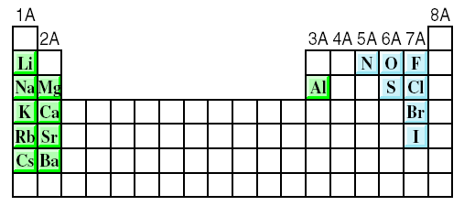
Ionic compounds
The most reactive metals (green) and the most reactive nonmetals (blue) combine to form ionic compounds.

Slide 42
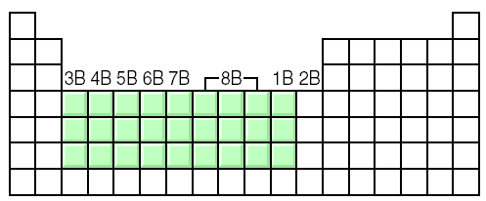
Transition metal ionic compounds
indicate charge on metal with Roman numerals
FeCl₂
2 Cl⁻ -2 so Fe is +2
iron(II) chloride
FeCl₃
3 Cl⁻ -3 so Fe is +3
iron(III) chloride
Cr₂S₃
3 S⁻² -6 so Cr is +3 (6/2)
chromium(III) sulfide

Slide 43
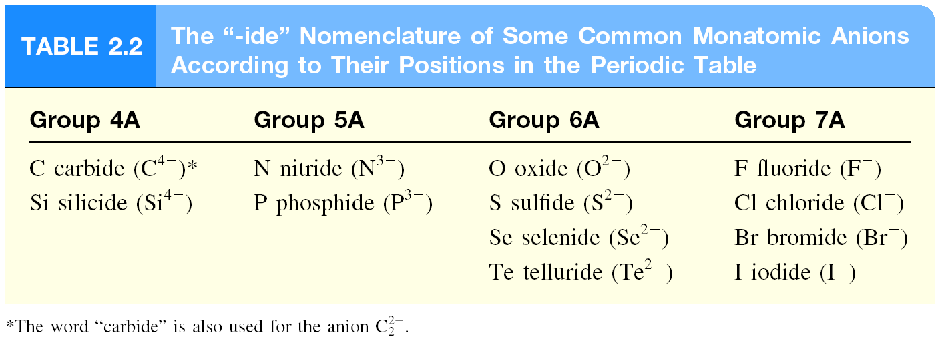

Slide 44
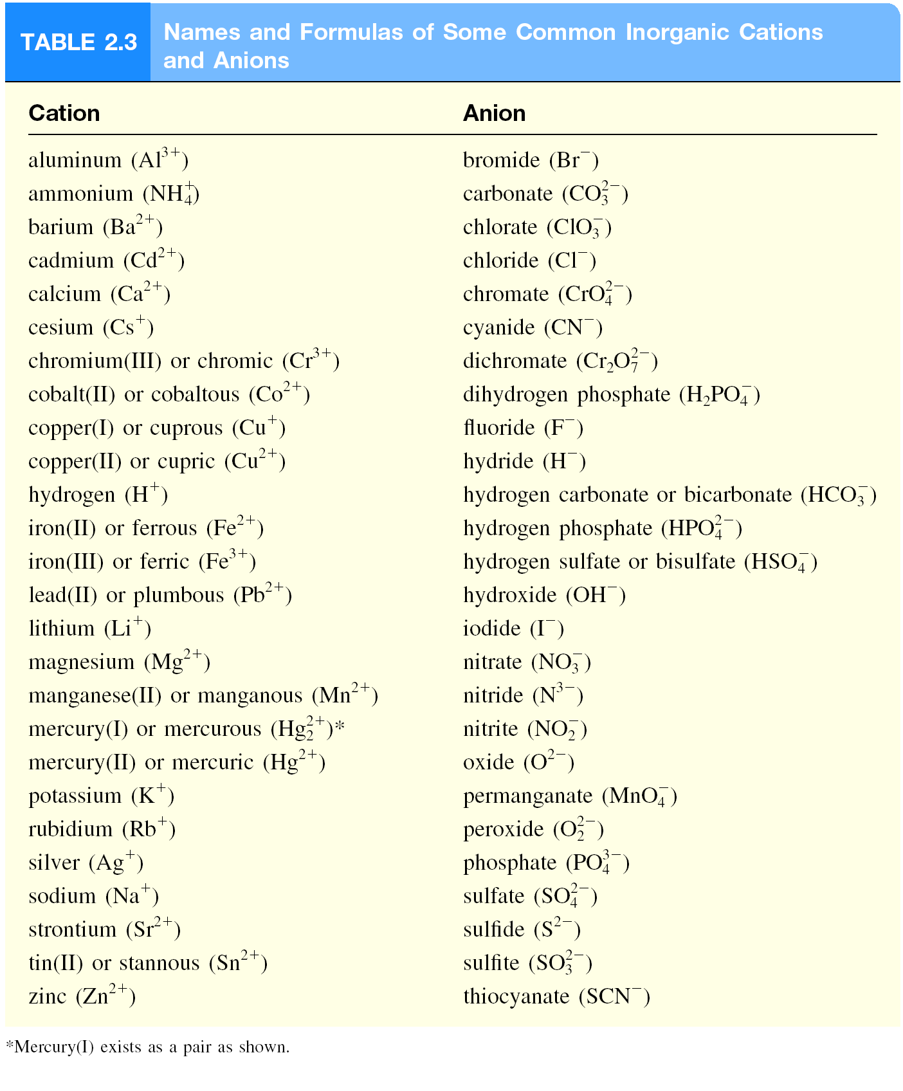

Slide 45
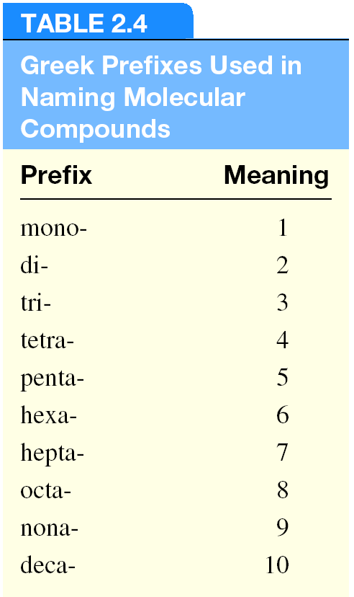
Molecular compounds
Nonmetals or nonmetals + metalloids
Common names H₂O, NH₃, CH₄,
Element furthest to the left in a period and closest to the bottom of a group on periodic table is placed first in formula
If more than one compound can be formed from the same elements, use prefixes to indicate number of each kind of atom
Last element name ends in ide

Slide 46
Molecular compounds
HI
hydrogen iodide
NF₃
nitrogen trifluoride
SO₂
sulfur dioxide
N₂Cl₄
dinitrogen tetrachloride
NO₂
nitrogen dioxide
N₂O
dinitrogen monoxide

Slide 47
Molecular compounds
Exceptions
exceptions to the use of Greek prefixes are molecular compounds containing hydrogen
called by their common name
do not indicate the number of hydrogen atom present
order of writing elements in the formulas is irregular
B₂H₆
diborane
CH₄
methane
SiH₄
silane
NH₃
ammonia
PH₃
phosphine
H₂O
water
H₂S
hydrogen sulfide

Slide 48
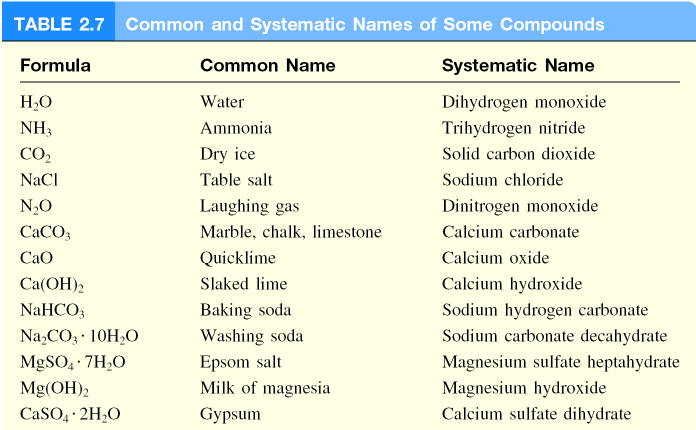

Slide 49
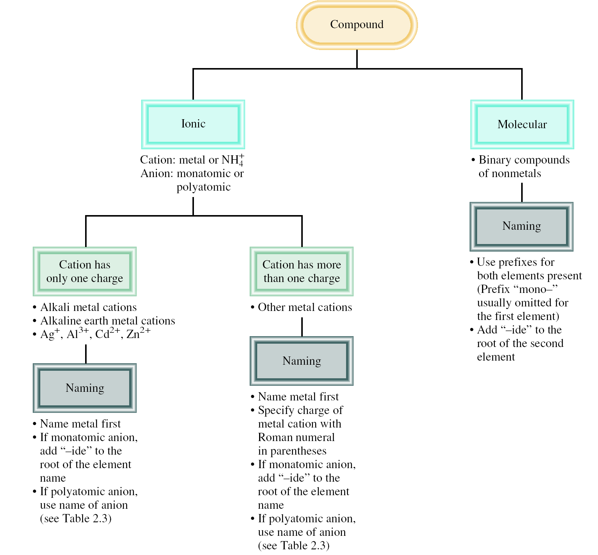

Slide 50
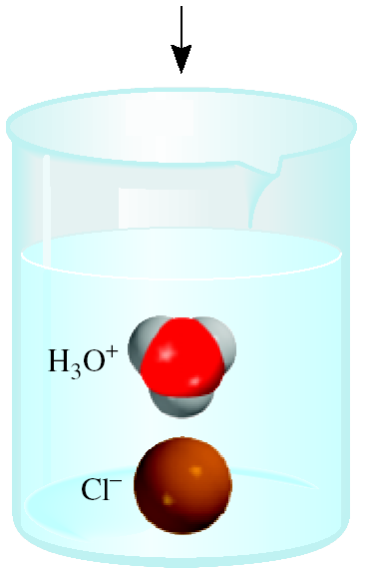
Acids and Bases
An acid can be defined as a substance that yields hydrogen ions (H⁺) when dissolved in water.
For example: HCl gas and HCl in water
Pure substance, hydrogen chloride
Dissolved in water (H₃O⁺ and Cl⁻), hydrochloric acid

Slide 51
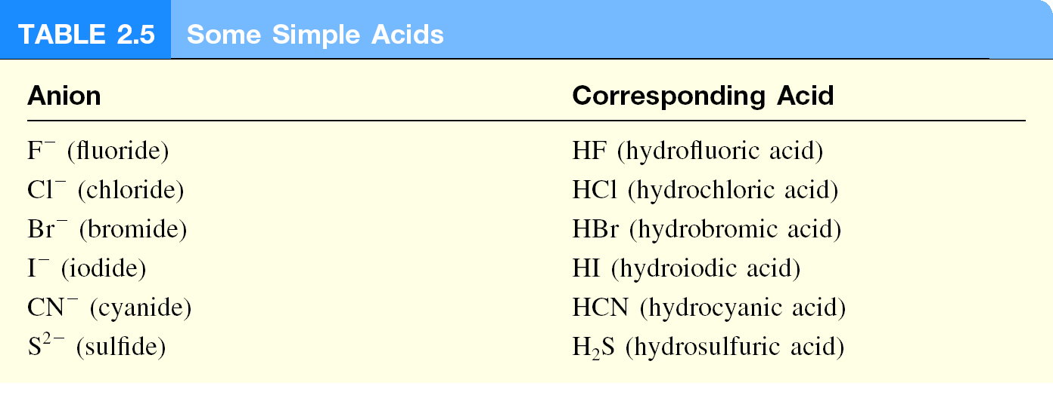

Slide 52
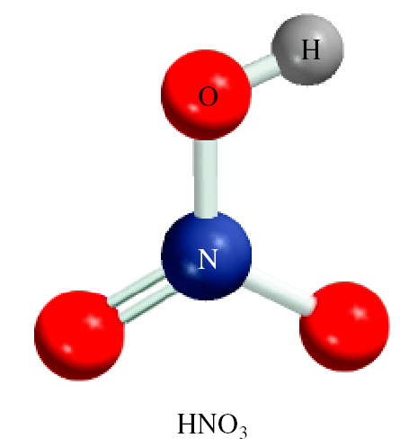
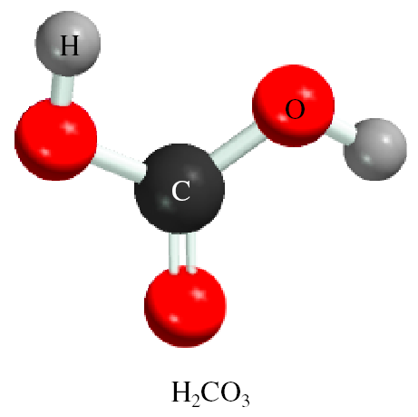
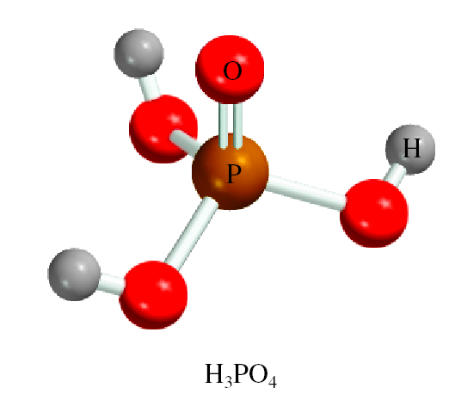
Oxoacid
An oxoacid is an acid that contains hydrogen, oxygen, and another element.
HNO₃
nitric acid
H₂CO₃
carbonic acid
H₃PO₄
phosphoric acid

Slide 53
Oxoanion
The rules for naming oxoanions, anions of oxoacids, are as follows:
When all the H ions are removed from the “-ic” acid, the anion’s name ends with “-ate”
When all the H ions are removed from the “-ous” acid, the anion’s name ends with “-ite”
The names of anions in which one or more but not all the hydrogen ions have been removed must indicate the number of H ions present. For example:
H₃PO₄ phosphoric acid H₂PO₄⁻ dihydrogen phosphate HPO₄²⁻ hydrogen phosphate PO₄³⁻ phosphate

Slide 54
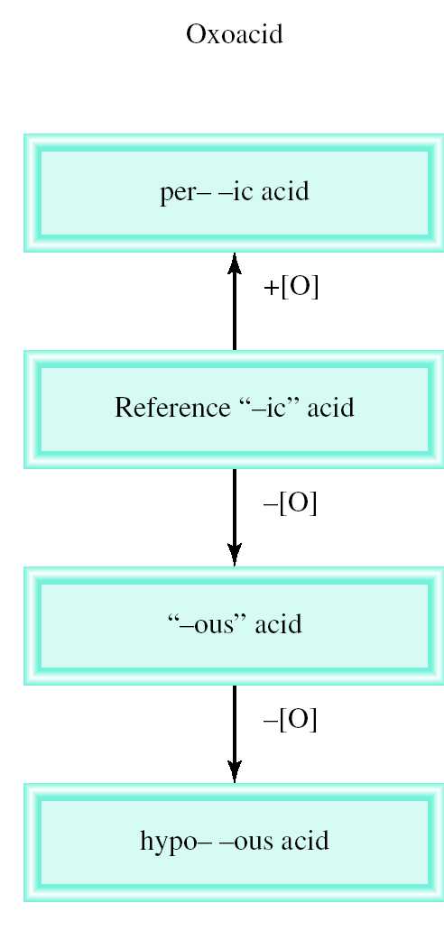
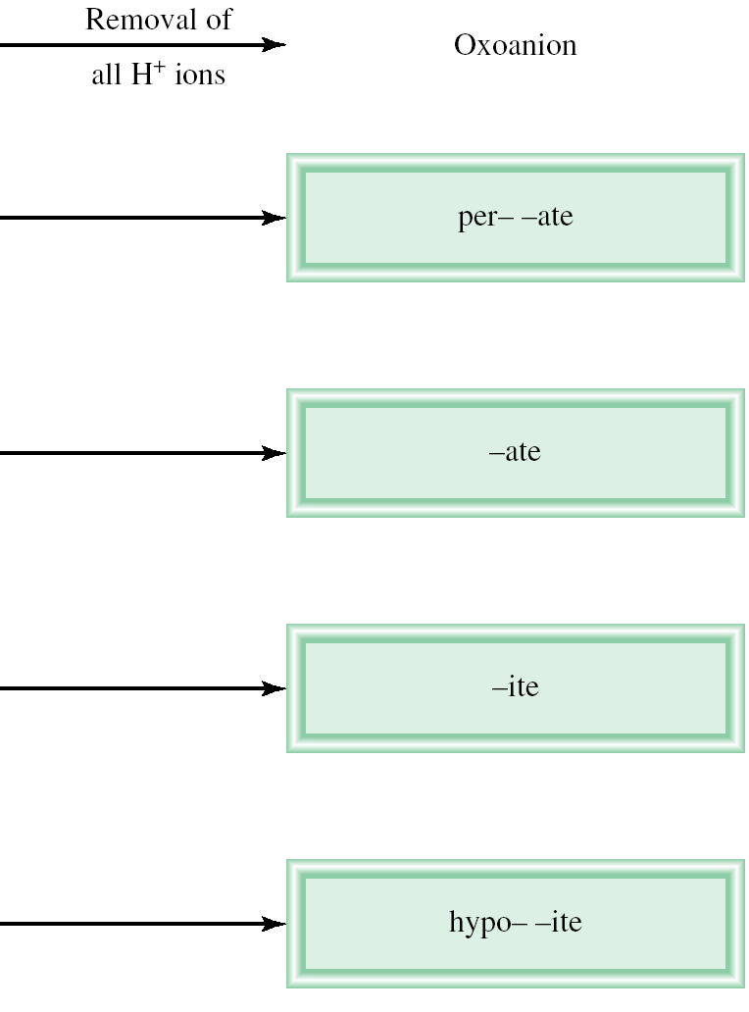
Naming Oxoacids and Oxoanions

Slide 55
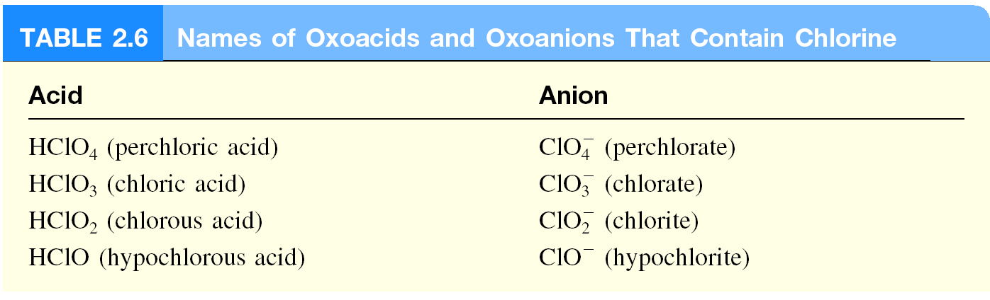

Slide 56
Base
A base can be defined as a substance that yields
hydroxide ions (OH⁻) when dissolved in water.
NaOH
sodium hydroxide
KOH
potassium hydroxide
Ba(OH)₂
barium hydroxide
NH₄OH
ammonium hydroxide
(NH₃ dissolved in water)

Slide 57
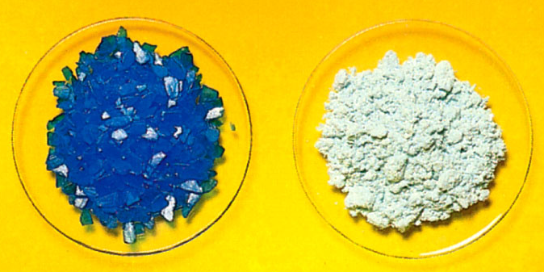
Hydrates
Hydrates are compounds that have a specific number of water molecules attached to them.
BaCl₂•2H₂O
barium chloride dihydrate
LiCl•H₂O
lithium chloride monohydrate
MgSO₄•7H₂O
magnesium sulfate heptahydrate
Sr(NO₃)₂ •4H₂O
strontium nitrate tetrahydrate
CuSO₄•5H₂O
CuSO₄

Slide 58
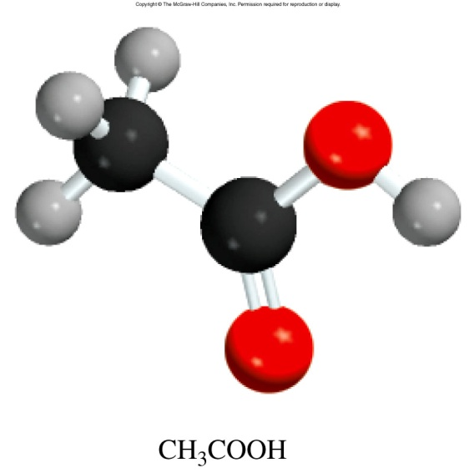

Organic chemistry
Organic chemistry is the branch of chemistry that deals with carbon compounds.
Functional Groups
H
H
H
O
H
C
OH
H
C
NH₂
H
C
C
OH
H
H
H
methylamine
acetic acid
methanol

Slide 59


Slide 60
Thank You

